Slide 1
Learning Rules Across the Brain
Randall C. O’Reilly
University of Colorado Boulder
eCortex, Inc.

Slide 2
Ultimate Goal: Build a Brain that Builds Itself..
Start with basic neural infrastructure…
Add a lot of real world experience…
Presto: instant human intelligence!
How does human brain pull off this magic trick?

Slide 3

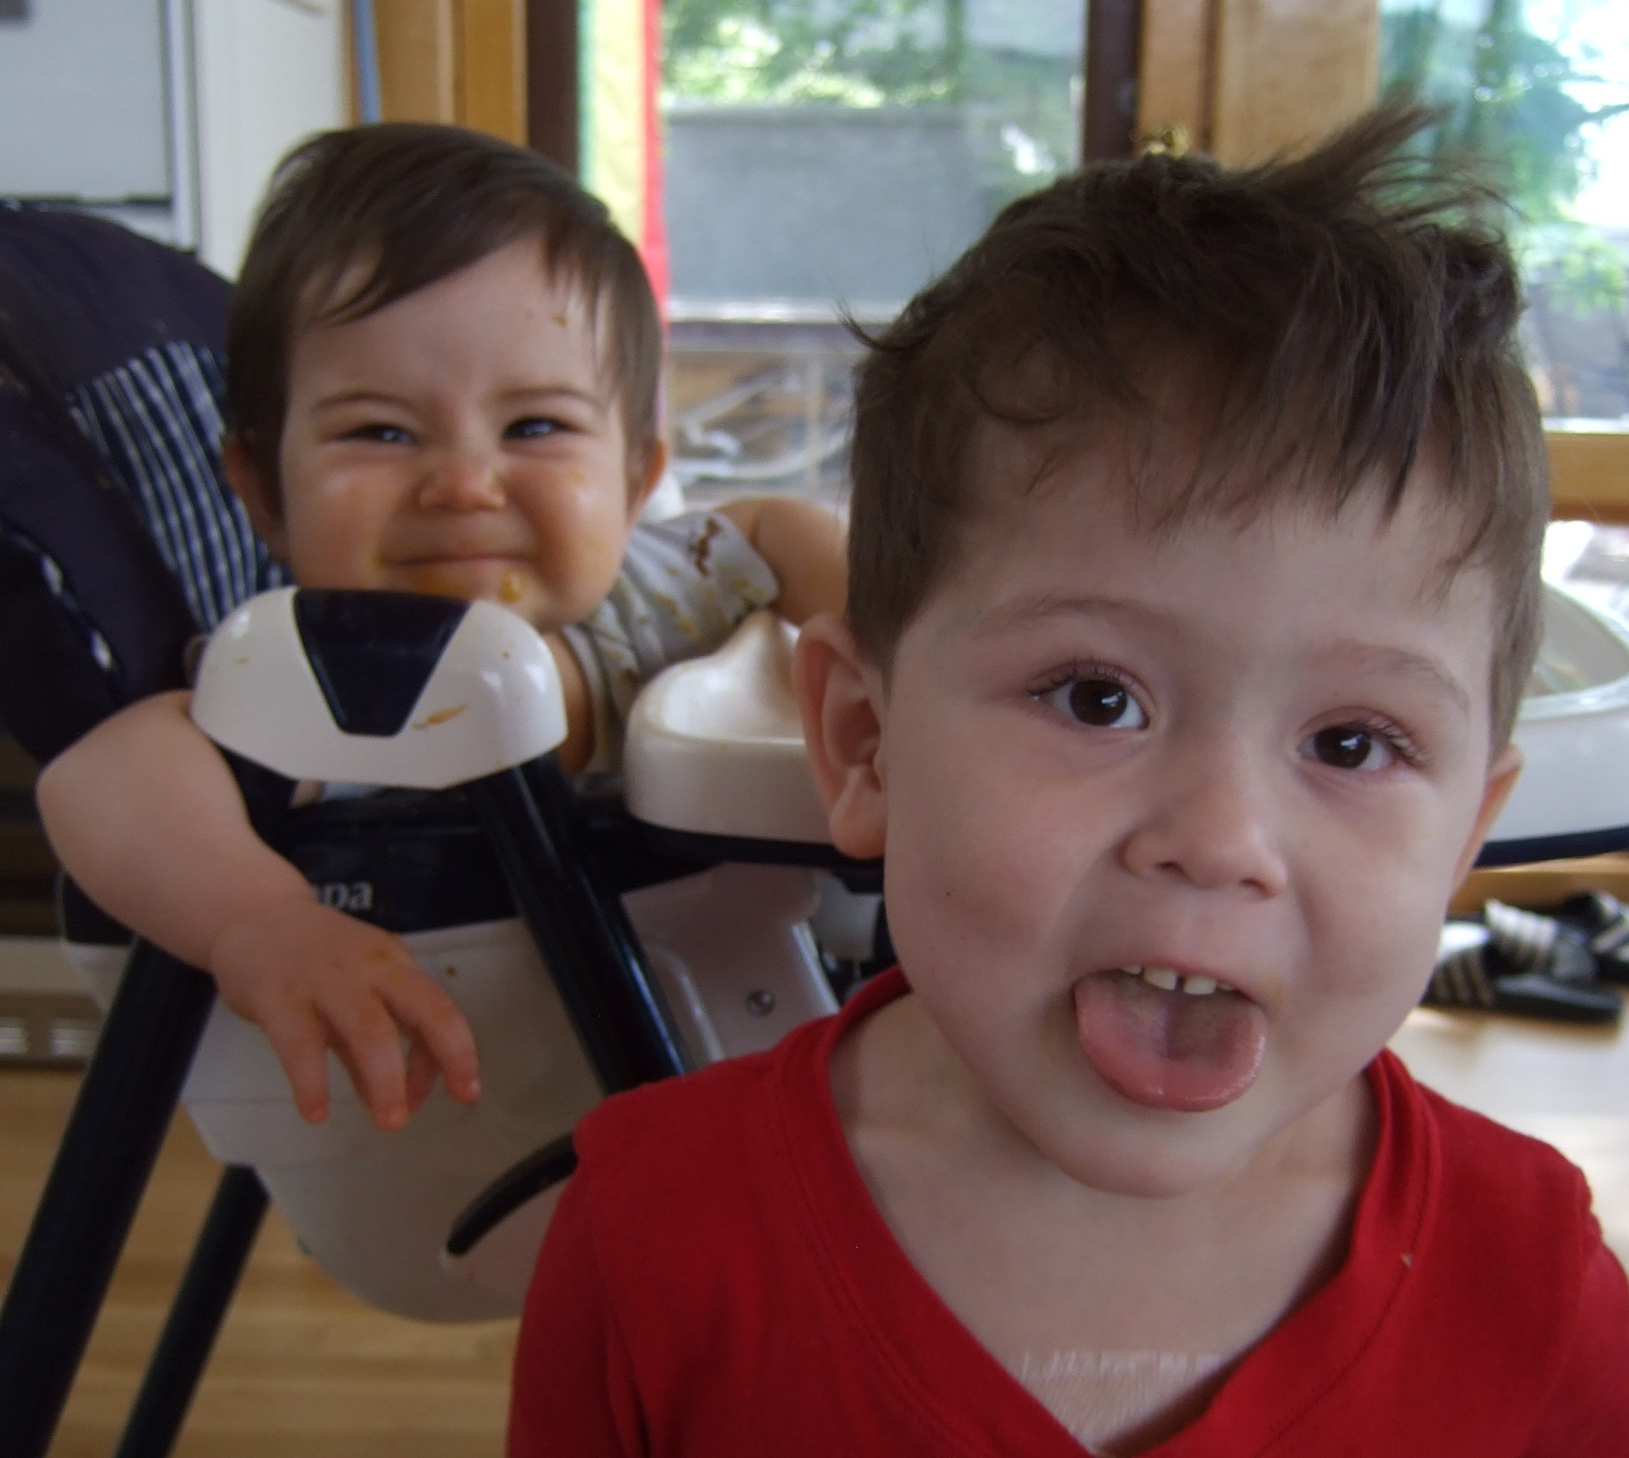
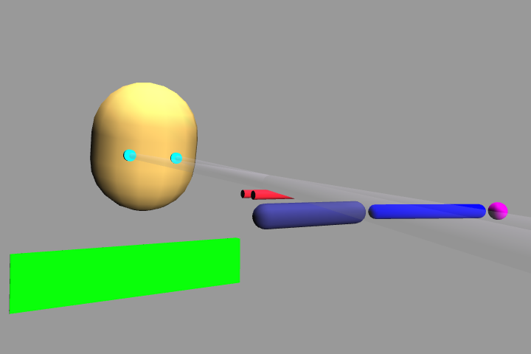
Kai (15mo)
Max (3.5yr)
Emer (?)
Notes:
* Let’s face it, this is what many of us really want to do: build some kind of artificial system that captures the essence of the human mind.
Our work on this is still in its infancy (so to speak), but we have already managed to extract some important lessons of general interest…
Basic point: what happens if we say “get a life” to our models: everyone has a richer experience from it

Slide 4
Learning Rules Across the Brain
Learning Signal
Dynamics
Area | Reward | Error | Self Org | Separator | Integrator | Attractor
Primitive Basal Ganglia | +++ | - - - | - - - | ++ | - | - - -
Cerebellum | - - - | +++ | - - - | +++ | - - - | - - -
Advanced Hippocampus | + | + | +++ | +++ | - - - | +++
Neocortex | ++ | +++ | ++ | - - - | +++ | +++
+ = has to some extent … +++ = defining characteristic – definitely has
- = not likely to have … - - - = definitely does not have

Slide 5
Primitive, Basic Learning..
Learning Signal
Dynamics
Area | Reward | Error | Self Org | Separator | Integrator | Attractor
Primitive Basal Ganglia | +++ | - - - | - - - | ++ | - | - - -
Cerebellum | - - - | +++ | - - - | +++ | - - - | - - -
Reward & Error = most basic learning signals
(self organized learning is a luxury..)
Simplest general solution to any learning problem is a
lookup table = separator

Slide 6
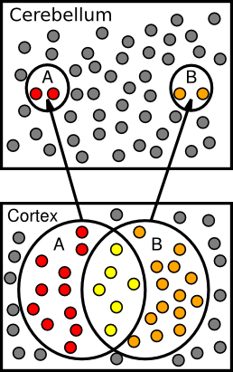
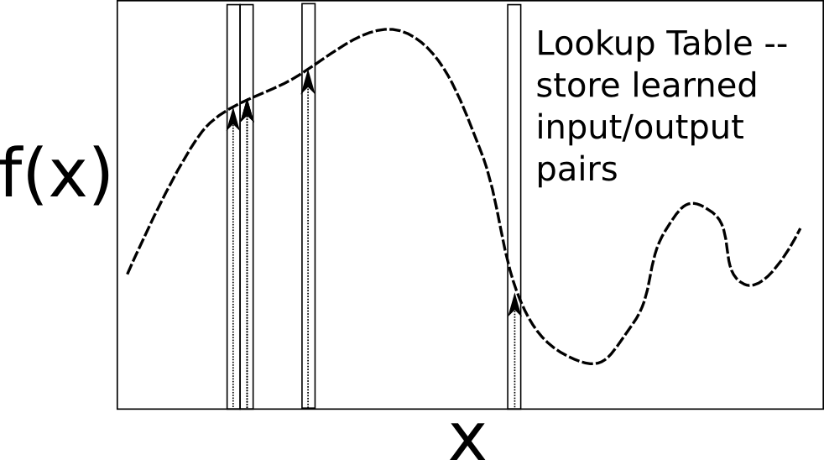
Lookup Table & Pattern Separation

Slide 7
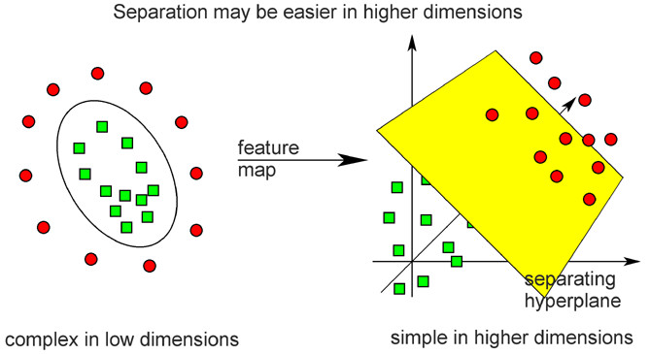
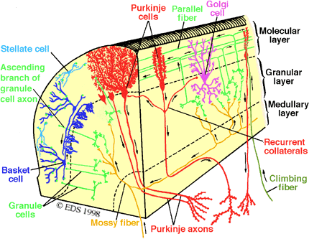
Cerebellar Error-driven Learning
Cerebellum =
Support Vector Machine
Granule cells = high-dimensional encoding (separation)
Purkinje/Olive = delta-rule error-driven learning
Classic ideas from Marr (1969) & Albus (1971)
Notes:
Time delayed weight changes
Can’t do backprop – need to have a generic all-purpose good-enough representation
First wave of computational modelers got the 1st principal component right on *everything*

Slide 8
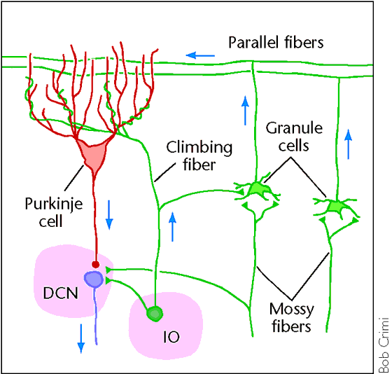
Cerebellum is Feed Forward
Feedforward circuit:
Input (PN) -> granules -> Purkinje -> Output (DCN)
Inhibitory interactions – no attractor dynamics
Key idea: does delta-rule learning bridging small temporal gap:
S(t-100) -> R(t)
^ Error(t+100)

Slide 9
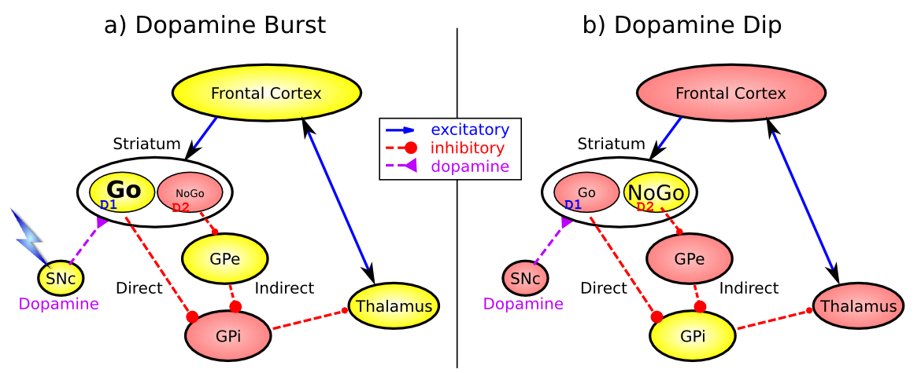
Basal Ganglia Reward Learning (Frank, 2005…; O’Reilly & Frank 2006)
Feedforward, modulatory (disinhibition) on cortex/motor
(same as cerebellum)
Co-opted for higher level cognitive control -> PFC

Slide 10
BG + Cerebellum Capacities
Learn what satisfies basic needs, and what to avoid (BG reward learning)
And what information to maintain in working memory (PFC) to support successful behavior
Learn basic Sensory -> Motor mappings accurately (Cerebellum error-driven learning)
Sensory -> Sensory mappings? (what is going to happen next..)

Slide 11
BG + Cerebellum Incapacities
Generalize knowledge to novel situations
Lookup tables don’t generalize well..
Learn abstract semantics
Statistical regularities, higher-order categories, etc
Encode episodic memories (specific events)
Useful for instance-based reasoning
Plan, anticipate, simulate, etc..
Requires robust working memory

Slide 12

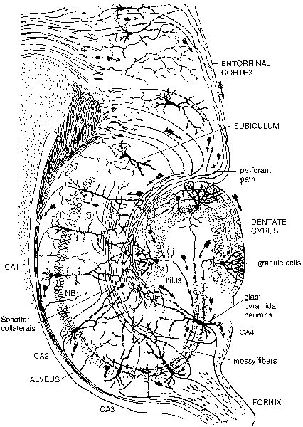
Hippocampal Episodic Memory
Area | Reward | Error | Self Org | Separator | Integrator | Attractor
Primitive Basal Ganglia | +++ | - - - | - - - | ++ | - | - - -
Cerebellum | - - - | +++ | - - - | +++ | - - - | - - -
Advanced Hippocampus | + | + | +++ | +++ | - - - | +++

Slide 13
Hebbian Learning = Automatic (O’Reilly & Rudy, 2001)
Hippocampus is a constant “tape recorder” of your life
You never know when something interesting might have happened 5 minutes ago..

Slide 14
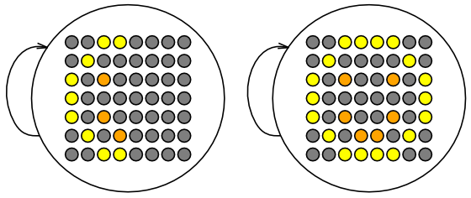
Recall = Attractor (content addressable memory..)
Recurrent connectivity is powerful but dangerous – hippocampus is major source of epilepsy..

Slide 15
Neocortex!
Learning Signal
Dynamics
Area | Reward | Error | Self Org | Separator | Integrator | Attractor
Primitive Basal Ganglia | +++ | - - - | - - - | ++ | - | - - -
Cerebellum | - - - | +++ | - - - | +++ | - - - | - - -
Advanced Hippocampus | + | + | +++ | +++ | - - - | +++
Neocortex | ++ | +++ | ++ | - - - | +++ | +++
Integrates many different experiences to generate
synthetic semantic knowledge (i.e., common sense),
serves as the basis for generalization
Integrative learning is necessarily slow!
(long life, neotonism) (McClelland, McNaughton & O’Reilly,1995)

Slide 16
Slow Integrative Learning
Average: each term weighted by 1/N
Running average: x(t) = x(t-1) + 1/τ(s(t) - x(t))
As 1/τ gets smaller, window of integration gets larger
Can’t average over everything!!
Just gives you a big gamoosh blob!
Integrative learning requires error-driven learning!

Slide 17
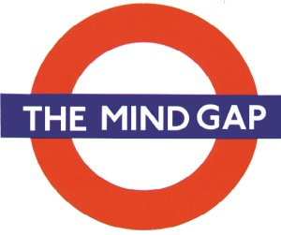
Spike Based Error-Driven Learning
: For 25 years:
Biology (Hebbian) < - > Cognition* (Backprop)
* e.g., recognizing 100’s of objects, learning to read..
Biology has advanced:
Spike Timing Dependent Plasticity (STDP)
Urakubo et al (2008) model: bottom-up brawn
Cognition too:
Backprop -> Contrastive Hebbian Learning (CHL), Deterministic / Restricted Boltzmann Machine, GeneRec, Xie & Seung…
Can we unify them once and for all??

Slide 18
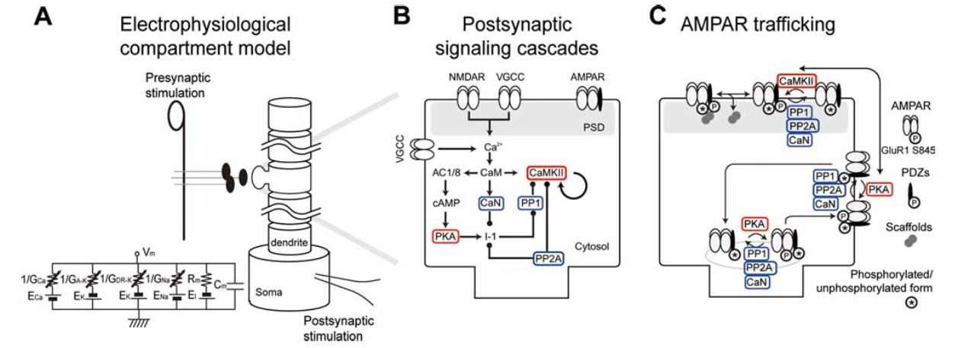
Urakubo et al, 2008 Model
Highly detailed combination of 3 existing strongly-validated models:

Slide 19
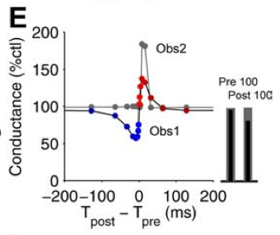
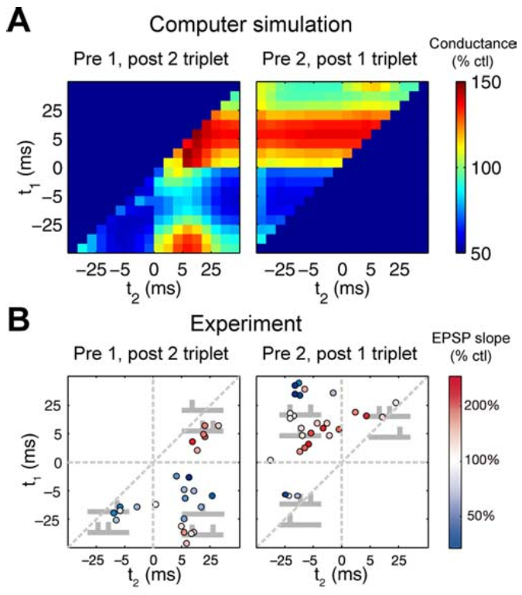
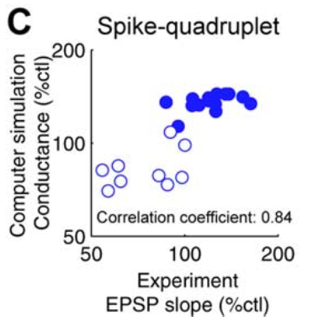
“Allosteric” NMDA Captures STDP (including higher-order and time integration effects)

Slide 20
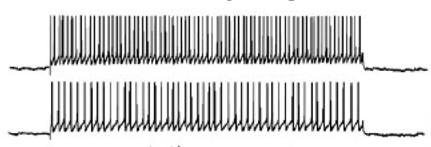
What About Real Spike Trains?

Slide 21
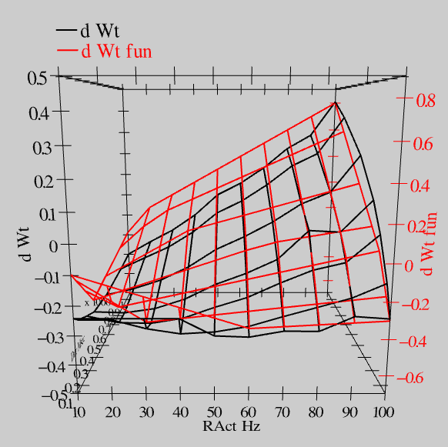
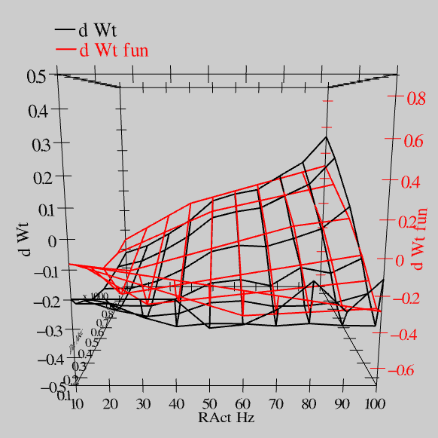
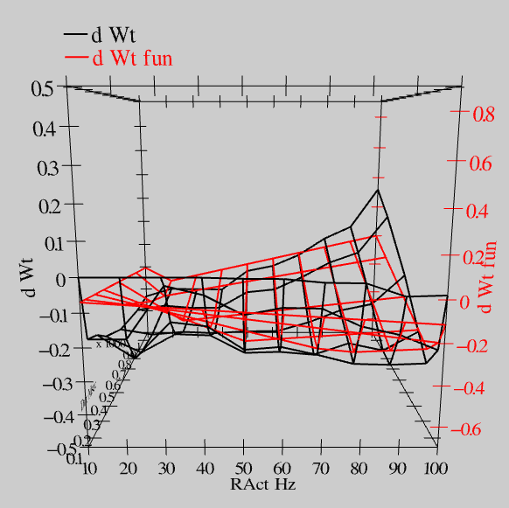
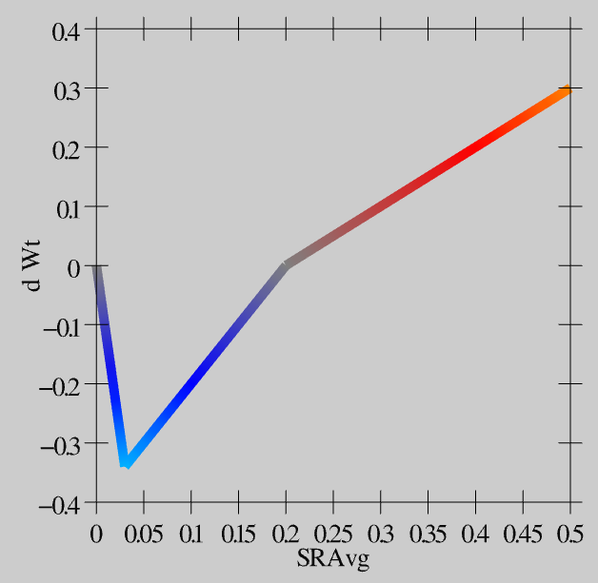
Extended Spike Trains = Emergent Simplicity
S = 100Hz
S = 50Hz
S = 20Hz
dW = f(send * recv) =
(spike rate * duration)
r=.894

Slide 22
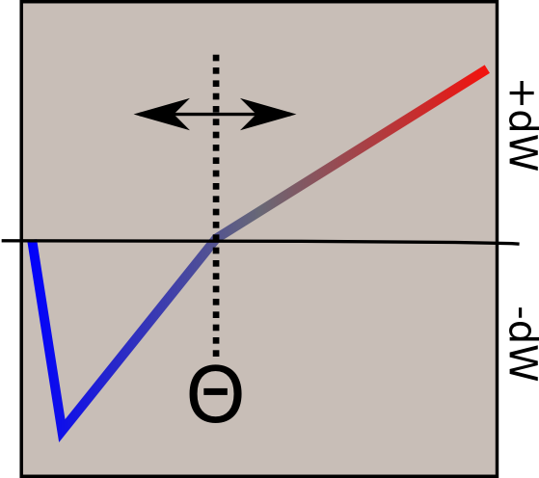
Linearized BCM
Bienenstock, Cooper & Munro (1982) – BCM:
adaptive threshold Θ
Lower when less active
Higher when more..
(homeostatic)

Slide 23
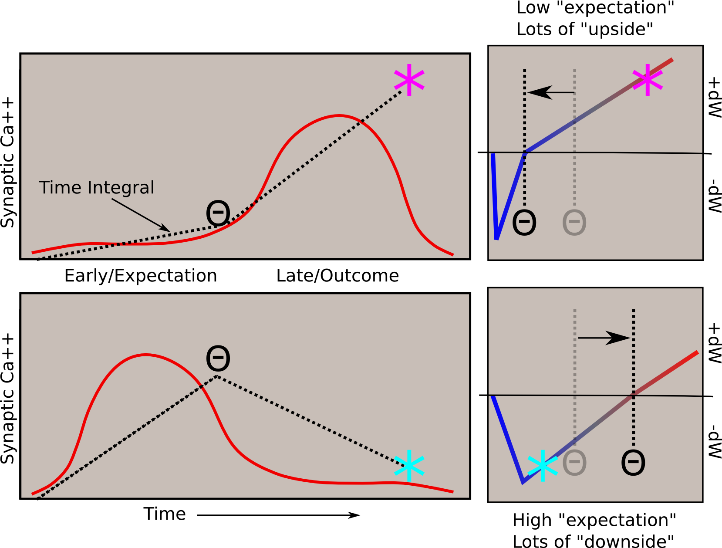
Fast Threshold Adaptation: Late Trains Early
Essence of Err-Driven: dW = outcome - expectation
Notes:
With a linear function, threshold is exactly what is subtracted

Slide 24
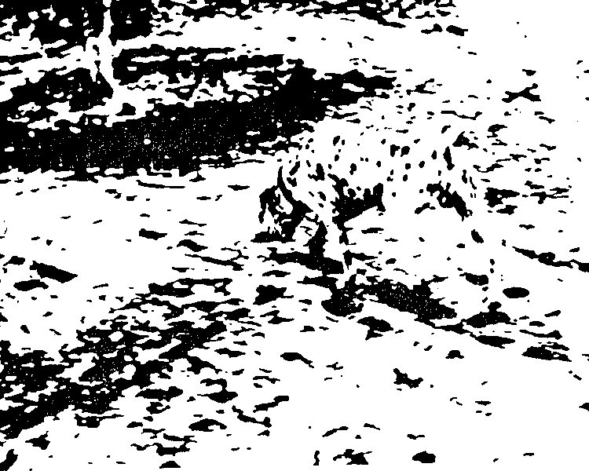

Neocortical Bidirectional Connectivity (Attractors)
Constraint satisfaction: higher-level interpretation feeds back to constrain lower-level feature detectors
Error-driven learning: conveys err signals

Slide 25
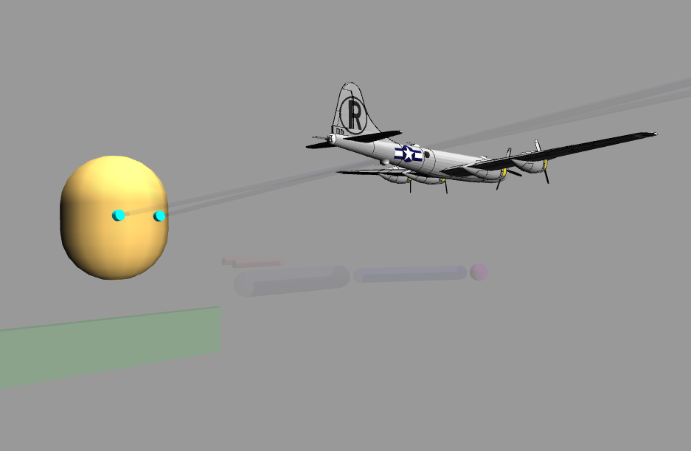
Emer Demo

Slide 26
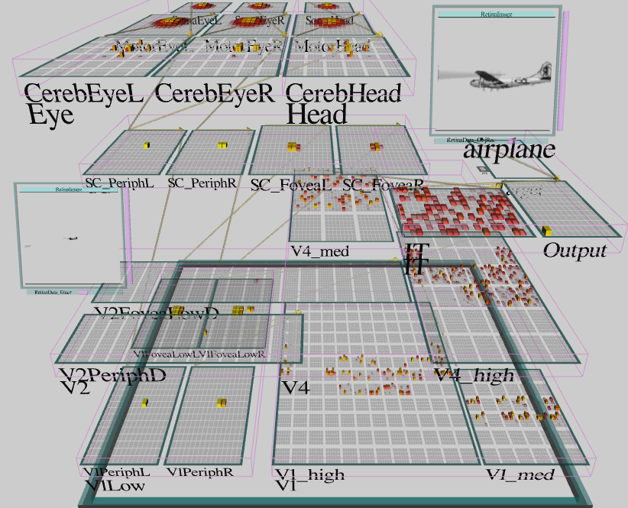
Emer’s Brain (Gaze + ObjRec)

Slide 27
Learning Rules Across the Brain
Learning Signal
Dynamics
Area | Reward | Error | Self Org | Separator | Integrator | Attractor
Primitive Basal Ganglia | +++ | - - - | - - - | ++ | - | - - -
Cerebellum | - - - | +++ | - - - | +++ | - - - | - - -
Advanced Hippocampus | + | + | +++ | +++ | - - - | +++
Neocortex | ++ | +++ | ++ | - - - | +++ | +++
+ = has to some extent … +++ = defining characteristic – definitely has
- = not likely to have … - - - = definitely does not have

Slide 28
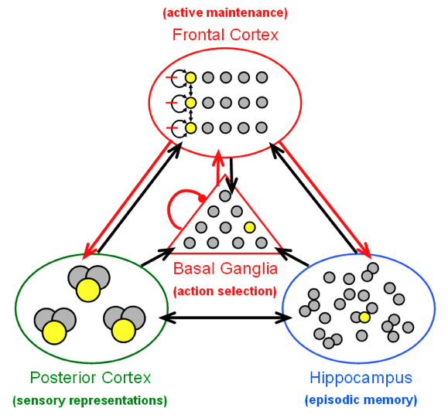
Leabra Tripartite Architecture
Common neural mechs
But specializations to resolve computational tradeoffs (e.g., fast, distinct learning vs. slow, integrative learning)
Control flows from BG action selection to PFC updating to top-down bias

Slide 29
Thanks To
Rich Ivry – lots of fun discussion at Yali’s!
CCN Lab
Brad Aisa (Auditory)
Tom Hazy (Learning)
Seth Herd (Learning)
Dave Jilk (Vision, eCortex)
Kenneth Latimer (Vision)
Brian Mingus (Motor)
Wolfgang Pauli (Attention)
Dean Wyatte (Vision)
Funding
ONR – McKenna & Bello
NIMH P50-MH079485
NIMH R01-MH069597
AFOSR
DARPA

Slide 30
Extras

Slide 31
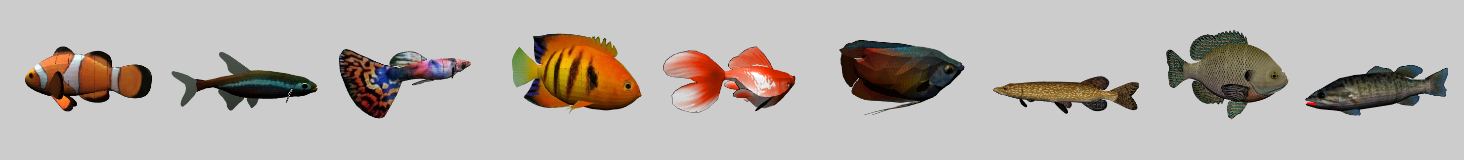
Object Recognition is Hard
Testing set
Training set
Large amount of shape variability within and between categories
Huge amount of view-based variability (position, orientation, size, rotation)

Slide 32
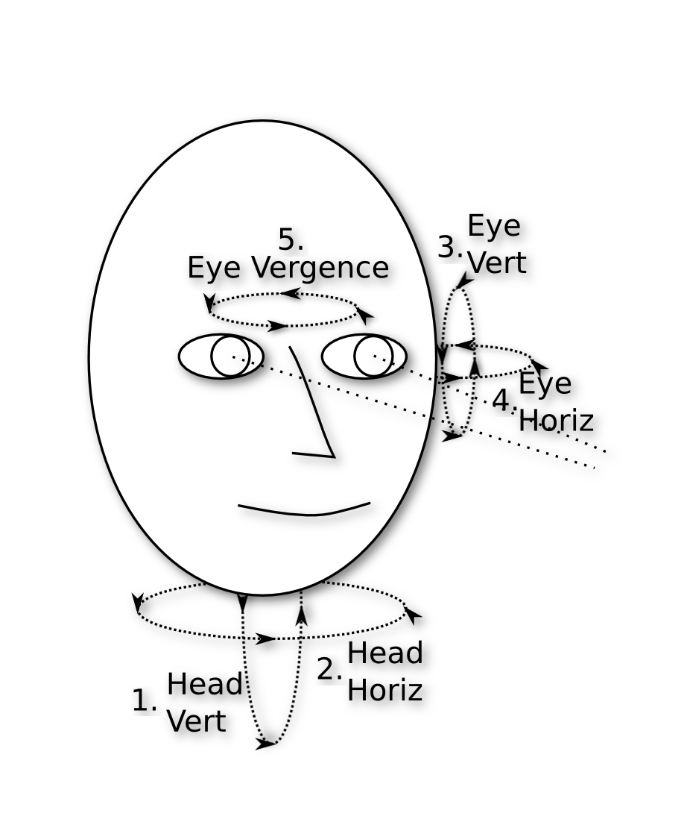
Learning to Look is Non-Trivial
5 DOF -> 3 dimensions
New gaze contingent on current positions
Head & eye coordination

Slide 33
How Emer’s Brain Works
Learning to Look
How a “dumb” signal can be smart (Kawato et al)
Recognizing Objects
Multi-modal learning signals in a bidirectionally-connected, hierarchically-organized network
Spike-based Learning
Bridging the gap between biology and cognition

Slide 34
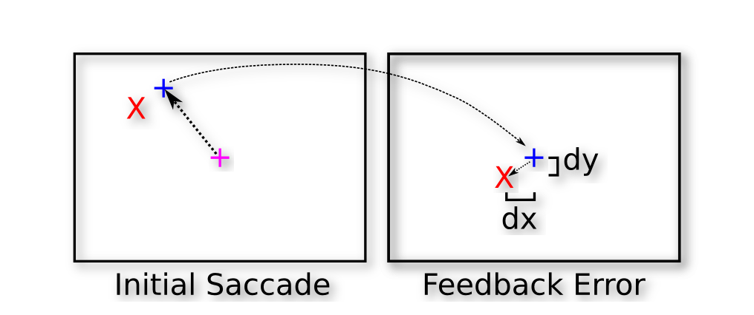
Learning to Look: Integrating over a “dumb” signal
Feedback error is in sensory coordinates
but applied directly to motor signal
(dumb = wrong coords, but only sensory is available; Kawato et al)
Notes:
Add disclaimer: not an expert in this, just stealing what seem to be good ideas..

Slide 35
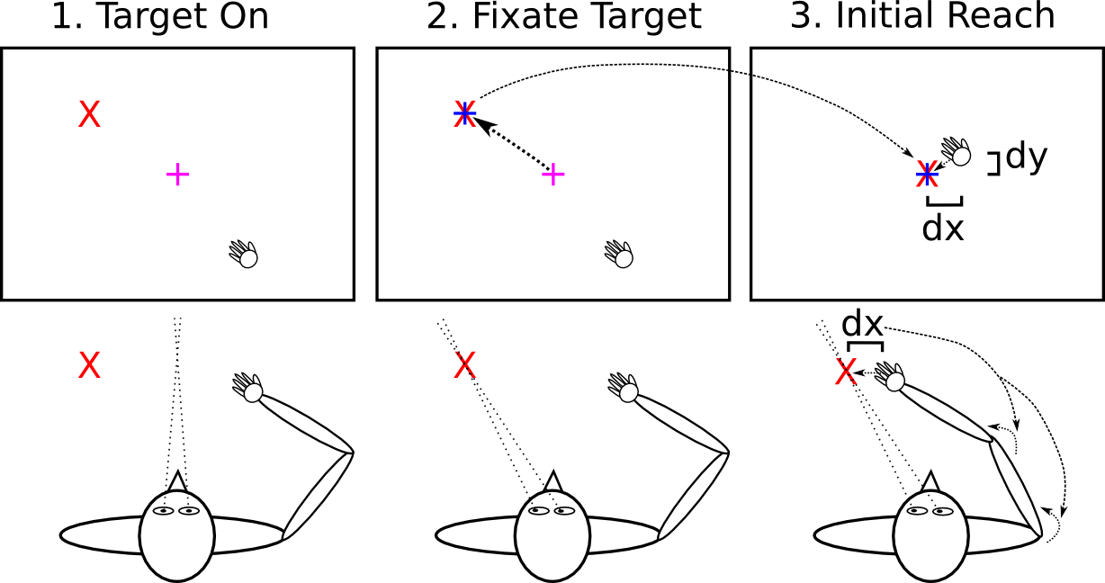
Looking to Reach: Same Error Signal, Different Muscles
Notes:
Requires accurate initial fixation – a cascade of learning all following from basic fixation.

Slide 36
How Emer’s Brain Works
Learning to Look
How a “dumb” signal can be smart (Kawato et al)
Recognizing Objects
Multi-modal learning signals in a bidirectionally-connected, hierarchically-organized network
Spike-based Learning
Bridging the gap between biology and cognition

Slide 37
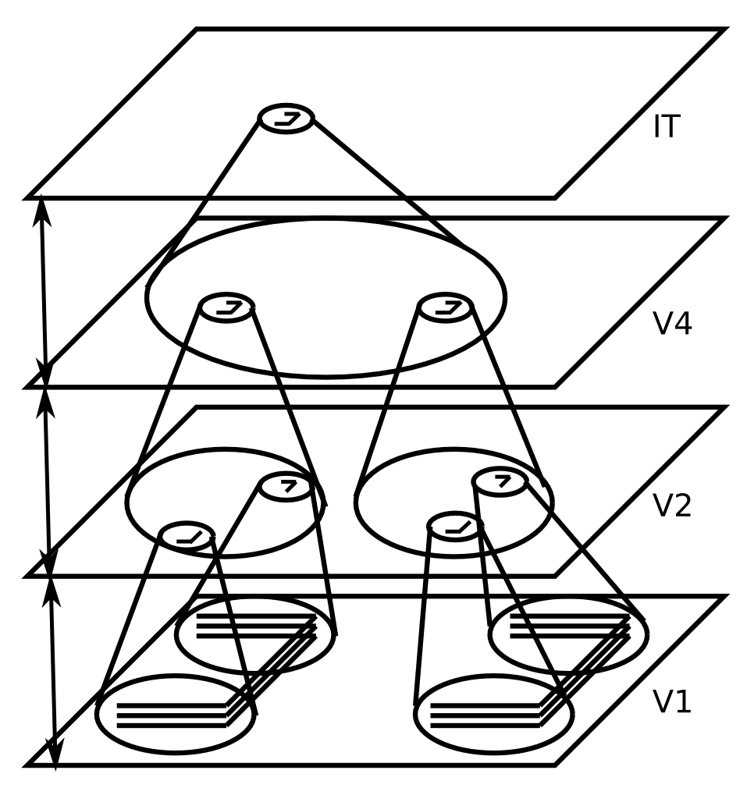
Invariant Object Recognition
Hierarchy of increasing:
Feature complexity
Spatial invariance
Strong match to RF’s in corresponding brain areas
(Fukushima, 1980; Poggio, Riesenhuber, et al…)

Slide 38
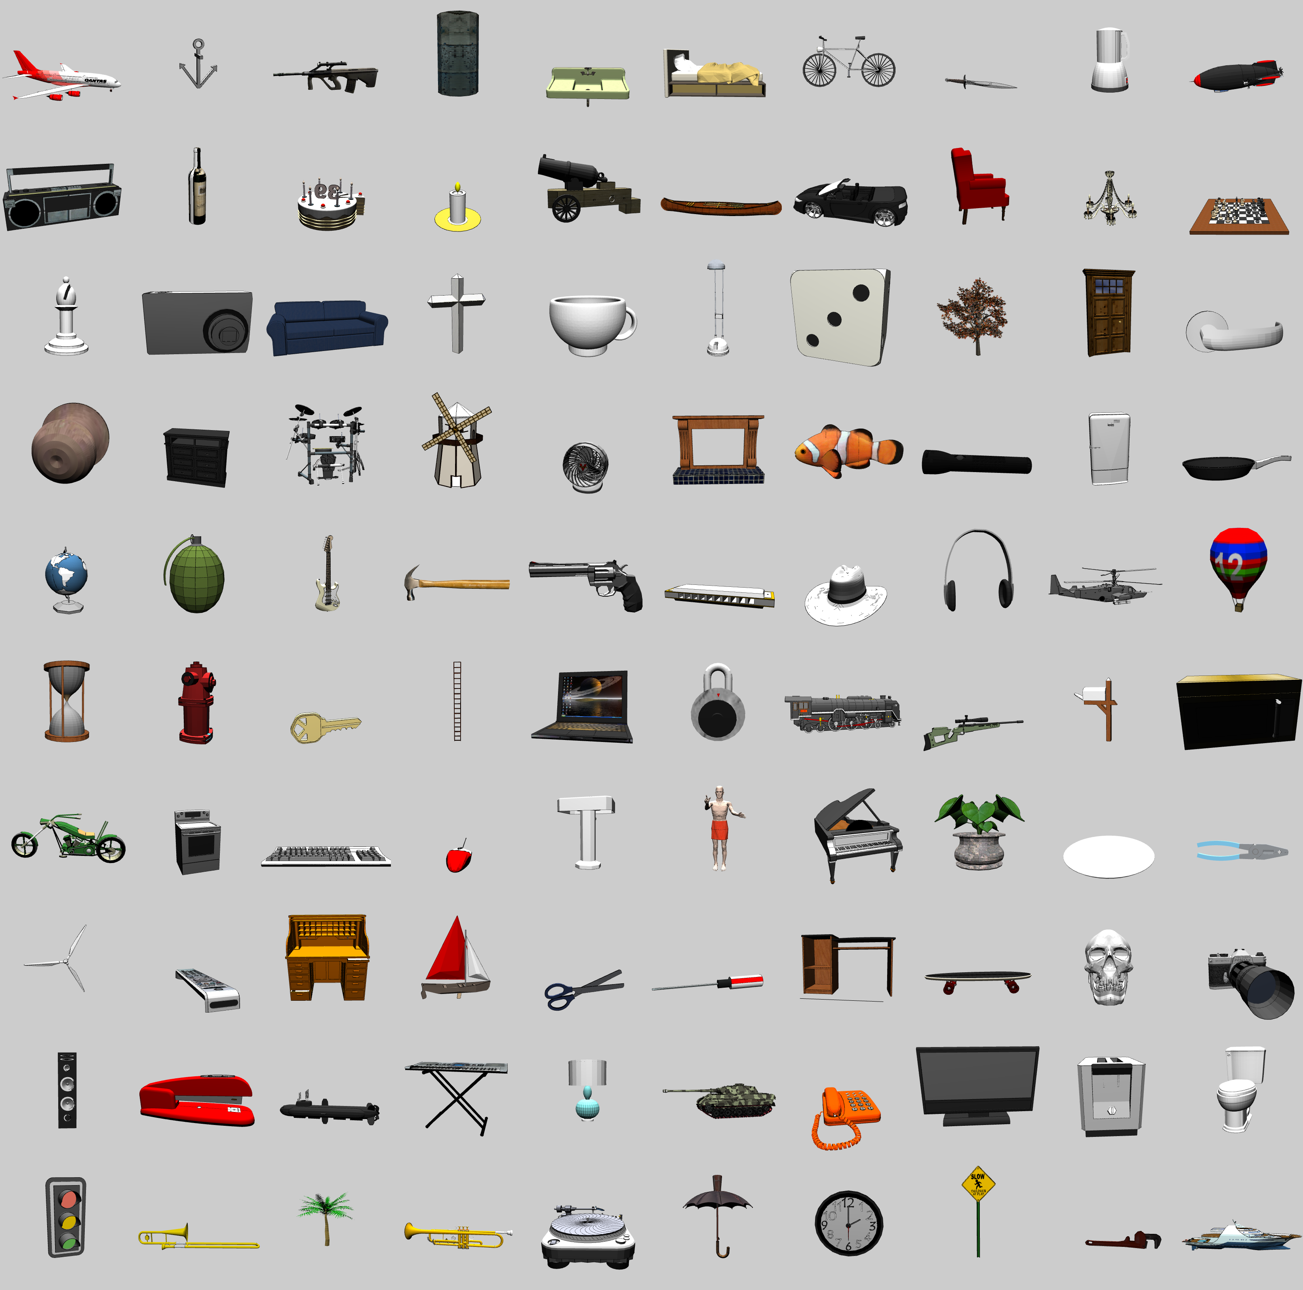
3D Object Recognition Test
From Google SketchUp Warehouse
100 categories
8+ objects per categ
2 objects left out for testing
+/- 20° horiz depth rotation + 180° flip
0-30° vertical depth rotation
14° 2D planar rotations
25% scaling
30% planar translations

Slide 39
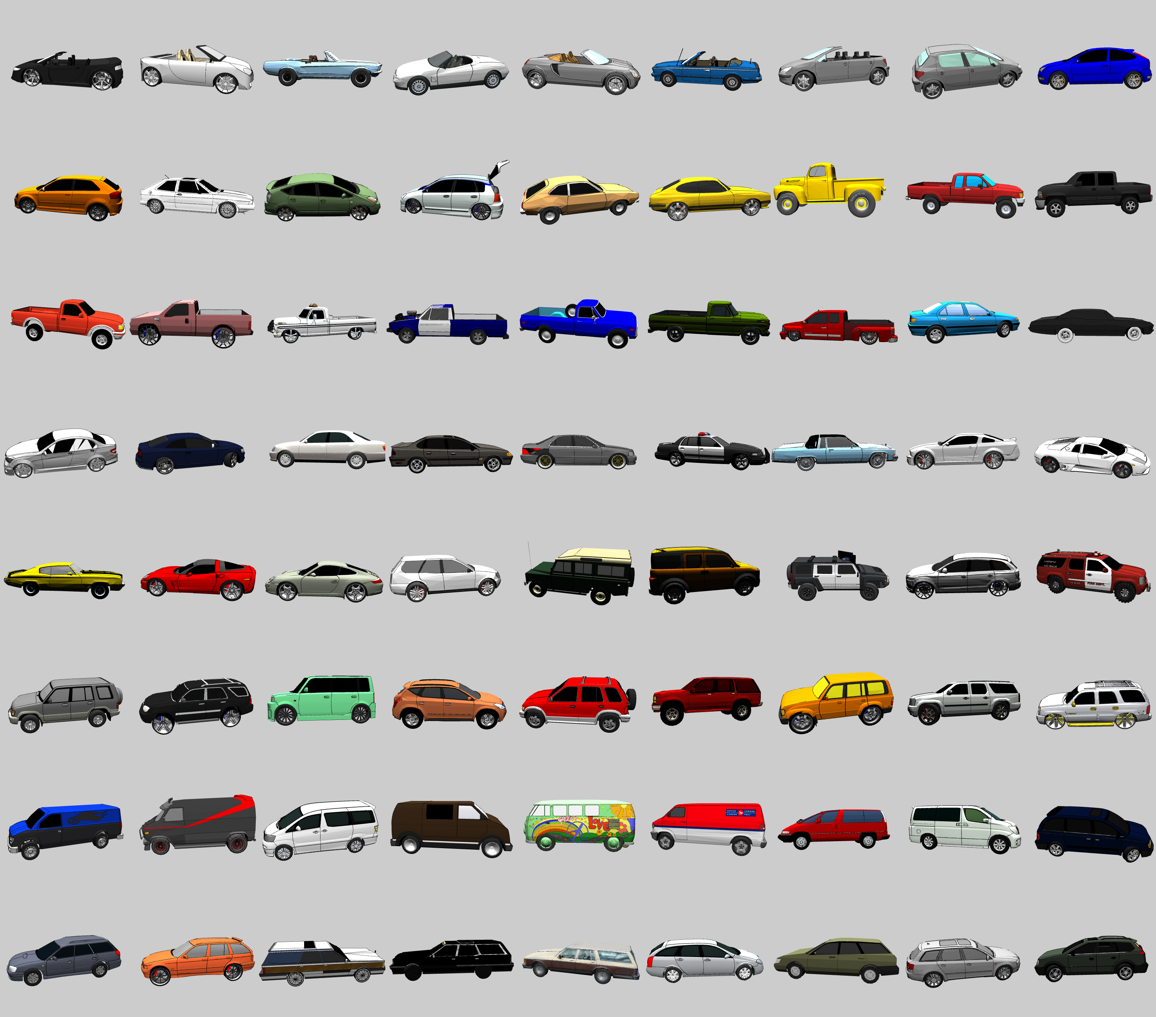
Objects in Car Category
Objects in Fish Category

Slide 40
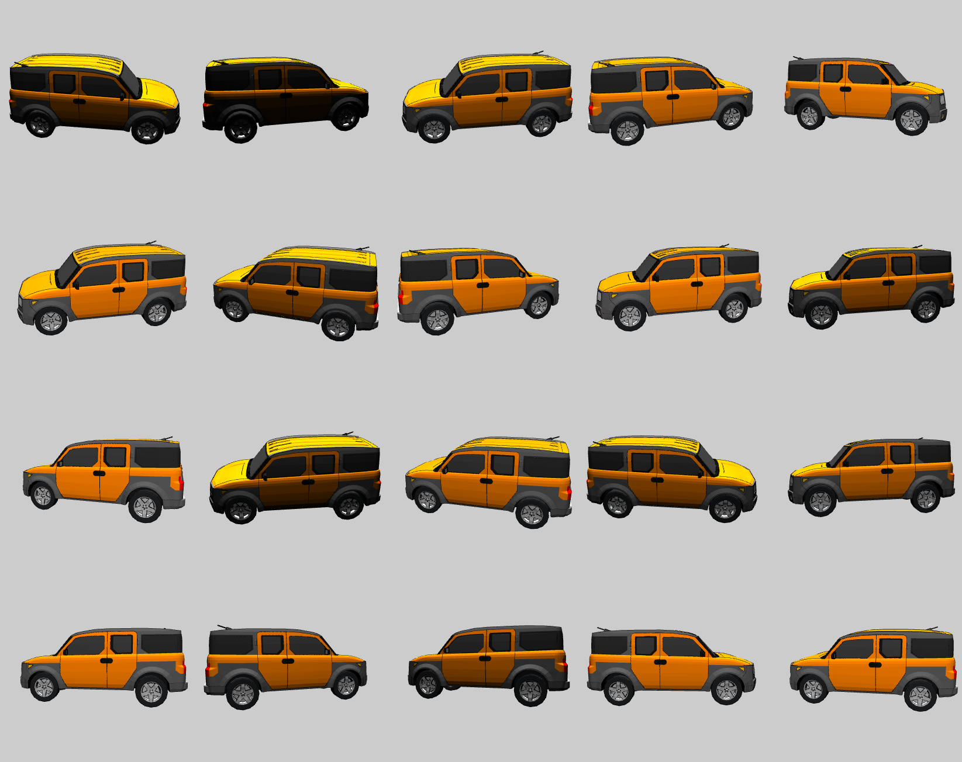
Depth & lighting variations for one object

Slide 41
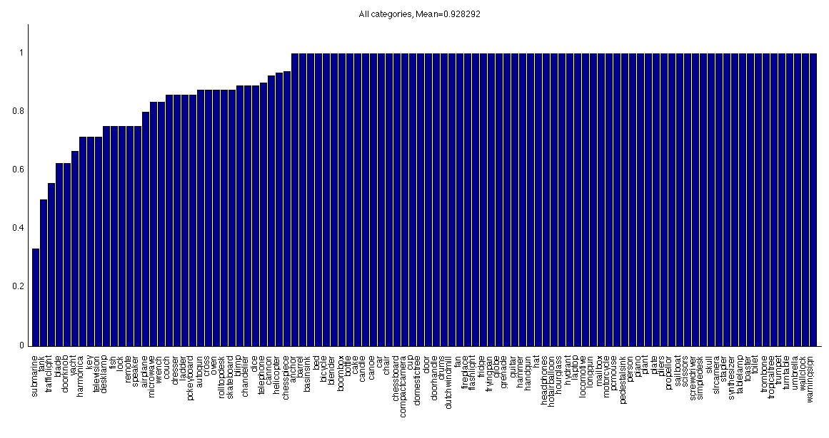
Generalization Results: 92.8%

Slide 42
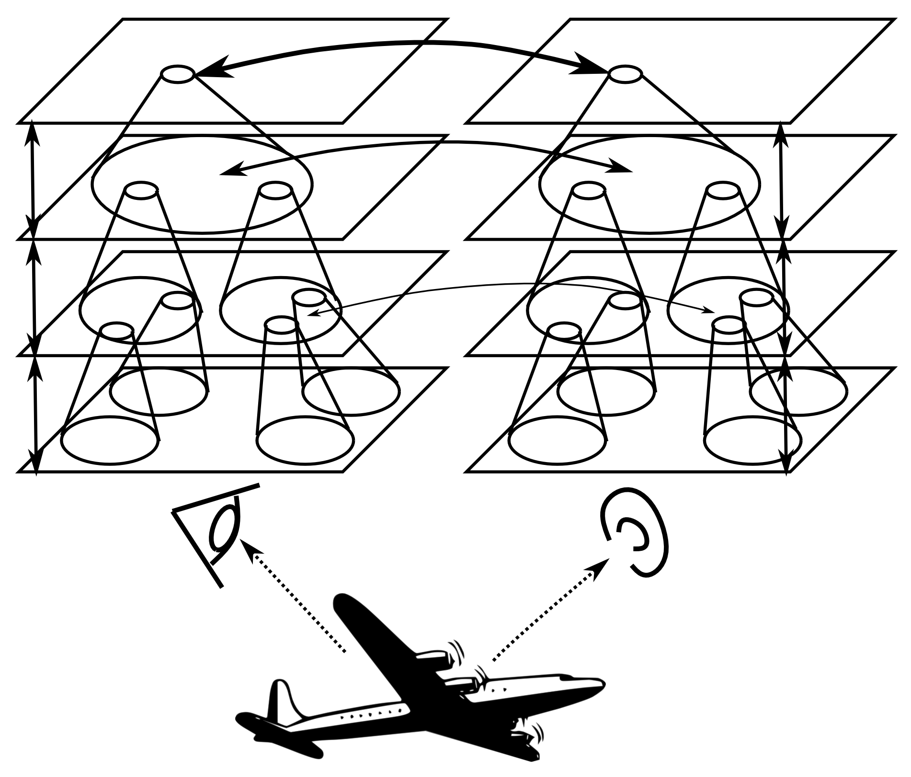
Bidirectional Multimodal Training
Notes:
Becker, deSa, etc

Slide 43
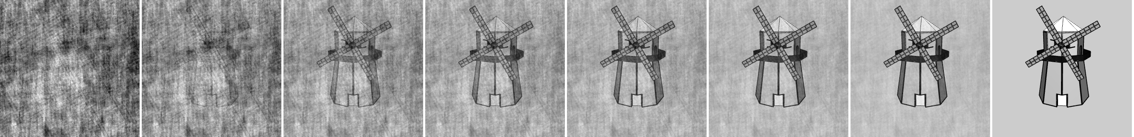
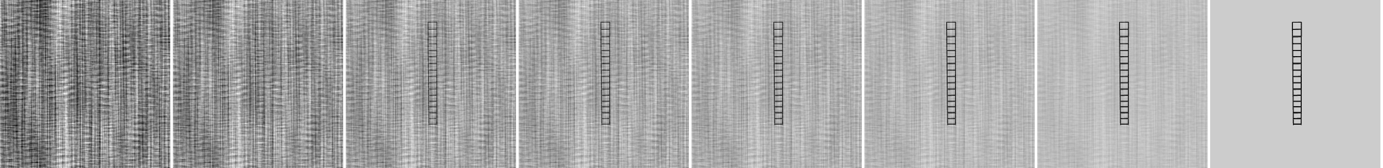
Benefit of Bidirectionality: Noise Robustness
Noise matched to image spatial frequency structure.

Slide 44
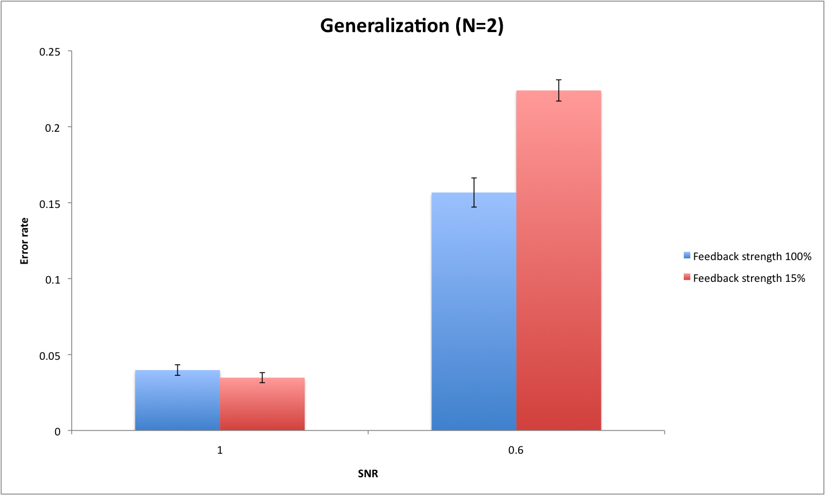
Benefit of Bidirectionality: Noise Robustness

Slide 45
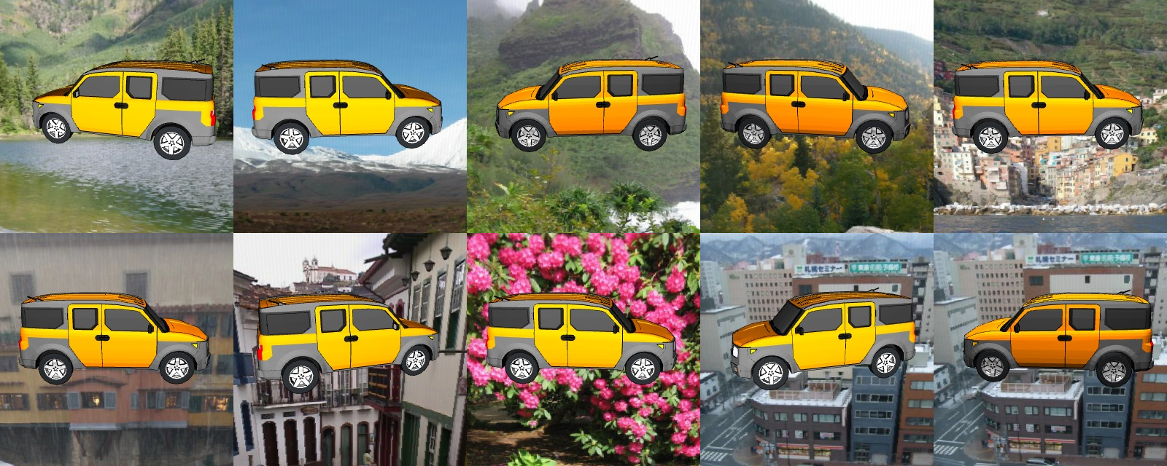
Cluttered Backgrounds
Performance degrades significantly
Need figure-ground segregation – in V2

Slide 46
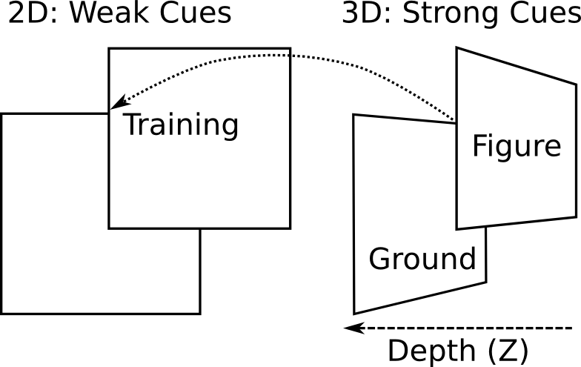
Embodied Figure Ground Learning
Binocular foveation ➔ disparity ➔ 3D depth
3D depth trains 2D depth/occlusion cues

Slide 47
How Emer’s Brain Works
Learning to Look
How a “dumb” signal can be smart (Kawato et al)
Recognizing Objects
Multi-modal learning signals in a bidirectionally-connected, hierarchically-organized network
Spike-based Learning
Bridging the gap between biology and cognition

Slide 48
Embodiment = Rich Continuous Source of Learning Signals
Every gaze is an automatic training signal
Multiple modalities driven by same environment
Visual fixation trains motor reaching
Object foveation ⬅➔ naming mutual training
Binocular foveation ➔ disparity ➔ 3D depth ➔ trains 2D depth ➔ figure-ground segregation ➔ object recognition in cluttered scenes
Notes:
Can be artificially simulated, but occurs naturally in real 3d world..

Slide 49
The Common Sense Problem
Thesis: Human common sense depends on intensive learning about physical world
More abstract cognitive functions build upon this sensory-motor foundation (Barsalou et al)
Need this common sense to truly understand natural language and interact with people

Slide 50
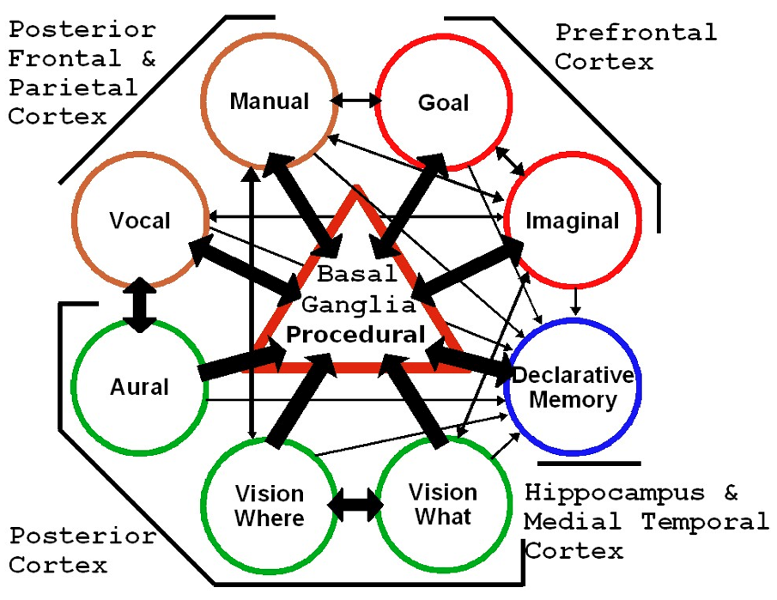
SAL = Synthesis of ACT-R & Leabra
Very close mapping between ACT-R and Leabra archs
Productive ongoing collaboration to explore & develop SAL.

Slide 51
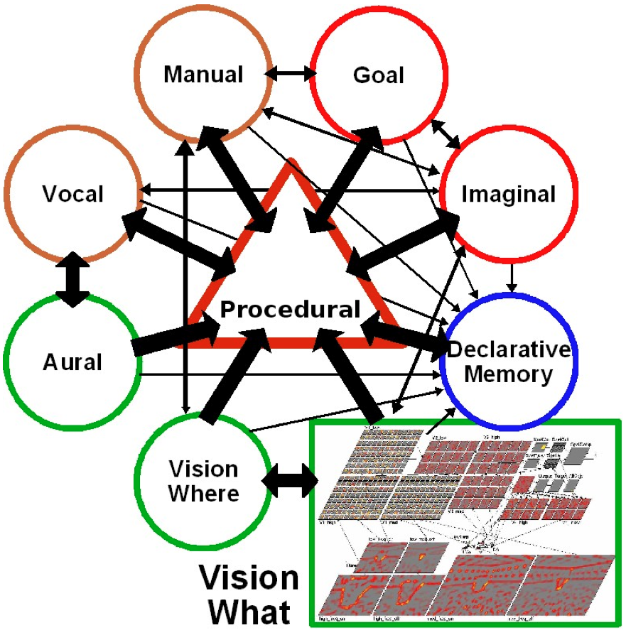
Simple Modular SAL
Replace ACT-R module with Leabra visual system
Achieves mutual benefits quickly
But not as satisfying as a fuller synthesis..

Slide 52
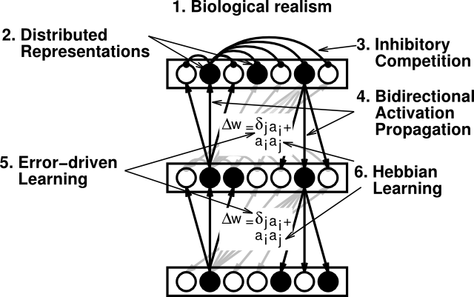
The Leabra Algorithm
Same algorithm (and mostly params) can simulate ~100 different cognitive phenomena!

